Slide 1
Single Page Applications with ASP.NET Core
Spencer Schneidenbach
@schneidenbach
spencer@avironsoftware.com

Slide 2
Comparison: standard page requests
Client Browser
Request: http://site.com/products/
Web Server
HTML
CSS
Images
Javascript
Response: Full page
Request: http://site.com/products/6
Response: Full page
HTML
CSS
Images
Javascript

Slide 3
Comparison: Single Page Application
Client Browser
Request: http://site.com/products/
Web Server
HTML
CSS
Images
Javascript
Response: Full page
Request: http://site.com/products/6
Response: Tiny bit of data
{product}

Slide 4
Why are we building SPAs
User Experience
Resume Building
Keeping Up With Other Web Devs
They’re Way Easier!

Slide 5

SPA Challenges
Concept Count Explosion
New Framework Every Day
Working with multiple languages
Managing state
Managing resources
Managing resource pipeline

Slide 6
Single Page Applications
Frameworks

Slide 7

AngularJS
<!doctype html>
<html ng-app="app">
<body>
<tabs>
<pane title="Localization">
Date: {{ '2013-04-01' | date:'fullDate' }} <br>
Currency: {{ 123456 | currency }} <br>
Number: {{ 98765.4321 | number }} <br>
</pane>
<pane title="Pluralization">
<div ng-controller="BeerCounter">
<div ng-repeat="beerCount in beers">
<ng-pluralize
count="beerCount“
when="beerForms">
</ng-pluralize>
</div>
</div>
</pane>
</tabs>
</body>
</html>
Custom Tag Attributes
Powerful Directives
Declarative Style
Strict Separation

Slide 8

React
Not MVC – Just V (UI)
Virtual DOM
One-way data flow
var HelloMessage = React.createClass({ render: function() { return <div>Hello {this.props.name}</div>; } }); ReactDOM.render(<HelloMessage name="John" />, mountNode);

Slide 9

Vue.js
<div id="app-6">
<p>{{ message }}</p>
<input v-model="message">
</div>
Approachable
Versatile
Performant
var app6 = new Vue({
el: '#app-6',
data: {
message: 'Hello Vue!'
}
})

Slide 10
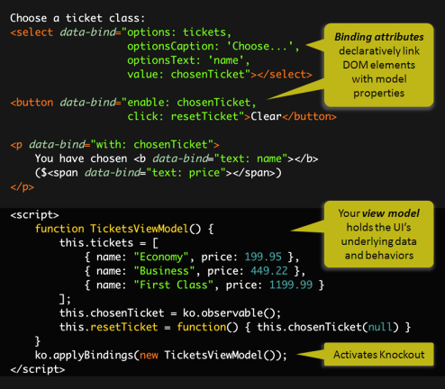
Knockout.js
Declarative Bindings
Automatic UI refresh
Dependency Tracking
Templating

Slide 11
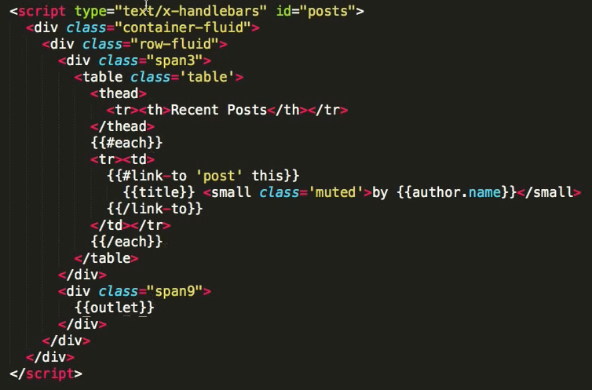

Ember.js
Ember is a framework
Convention over config
URLs are important

Slide 12
JavaScript Tools

Slide 13
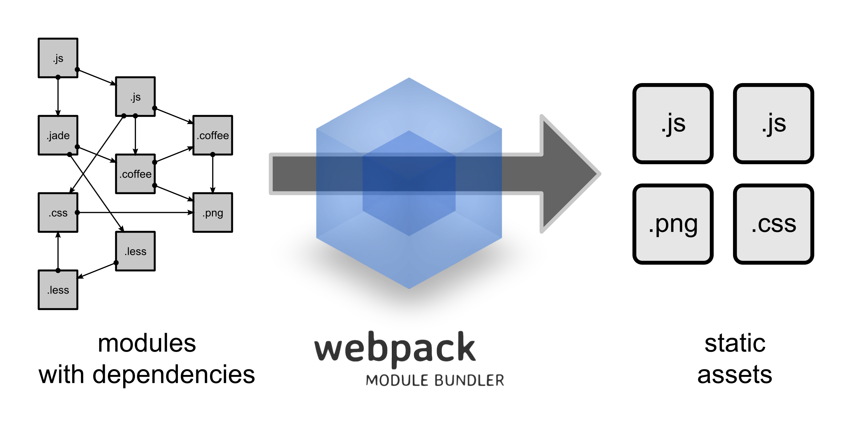
Web Pack

Slide 14
JavaScriptServices
Useful infrastructure for SPA’s on ASP.NET Core
Hosts Webpack to compile and serve client-side code
Advanced features like Hot Module Reloading and client / server side routing integration
Can invoke arbitrary NPM packages from .NET code
https://github.com/aspnet/JavaScriptServices

